Slide 1
Successful and unsuccessful escaping attempts
into West Germany (BRD)

Slide 2
Index
Georg Orth (successful)
Josef Grusser (aiding)

Slide 3
Birgit Lubusch abetting a sleeping soldier
1982 at 2am in a train from Eisenach to border station
Train operator Birgit Lubusch finds a sleeping soldier from DDR troop
Helped him jump off the train
Both knew the consequences of him staying in the train would be his imprisonment

Slide 4
The unsuccessful escape of B.F.
On 24th December 1975 B.F. and his friend got hit by a fragmentation mine before he could cross border
Almost died at the border
Was transported to a hospital, later into prison; meanwhile he was declared dead by the Americans
After the reunification he clarified it

Slide 5
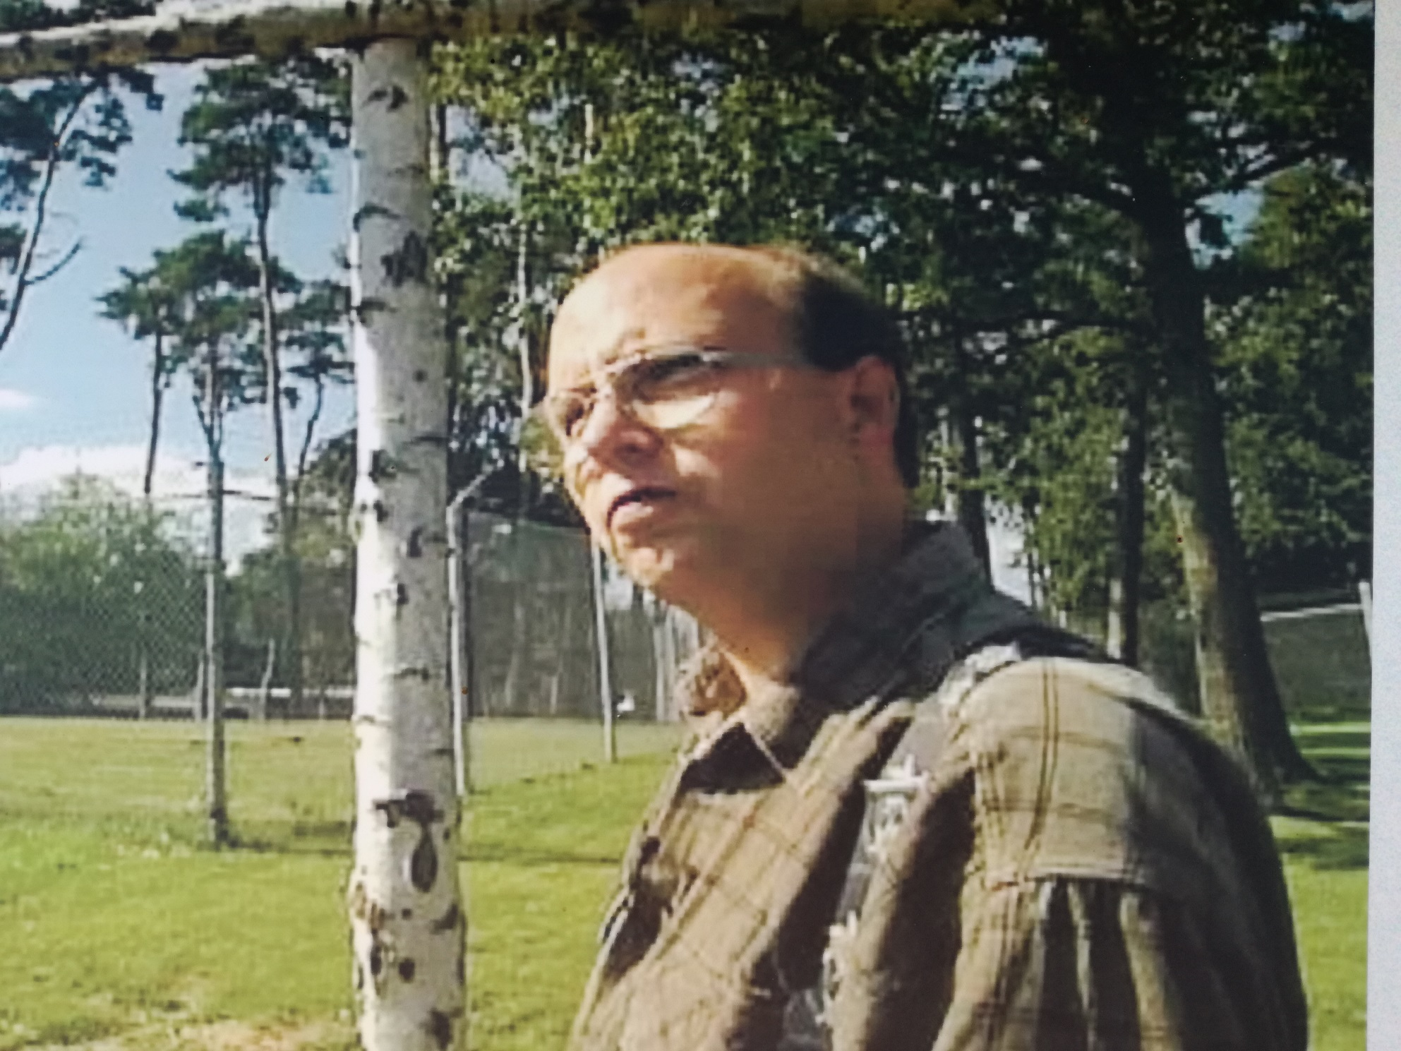

Slide 6
