Slide 1
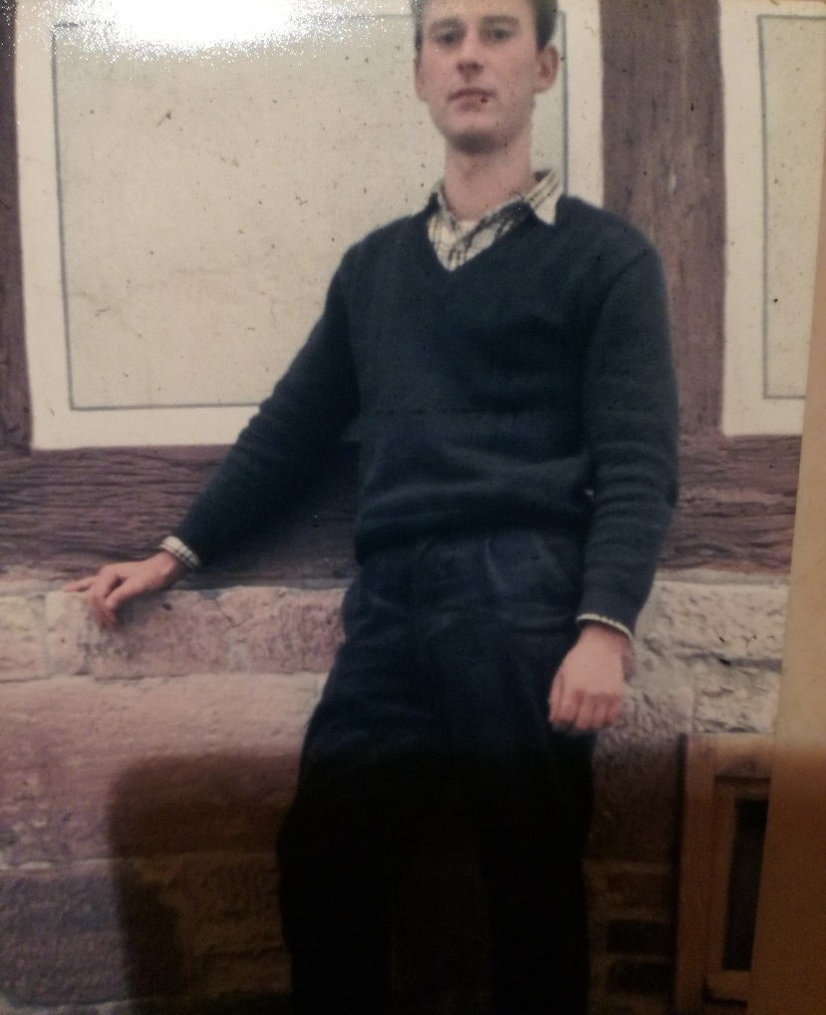
The successful escape of Georg Orth
07th October 1969 (Day of the Republic)
Fled because he wasn’t able to go to university in the DDR
Escaped through drainage ditch
Got registered in BRD and studied at last
Used his life later on to travel the world

Slide 2
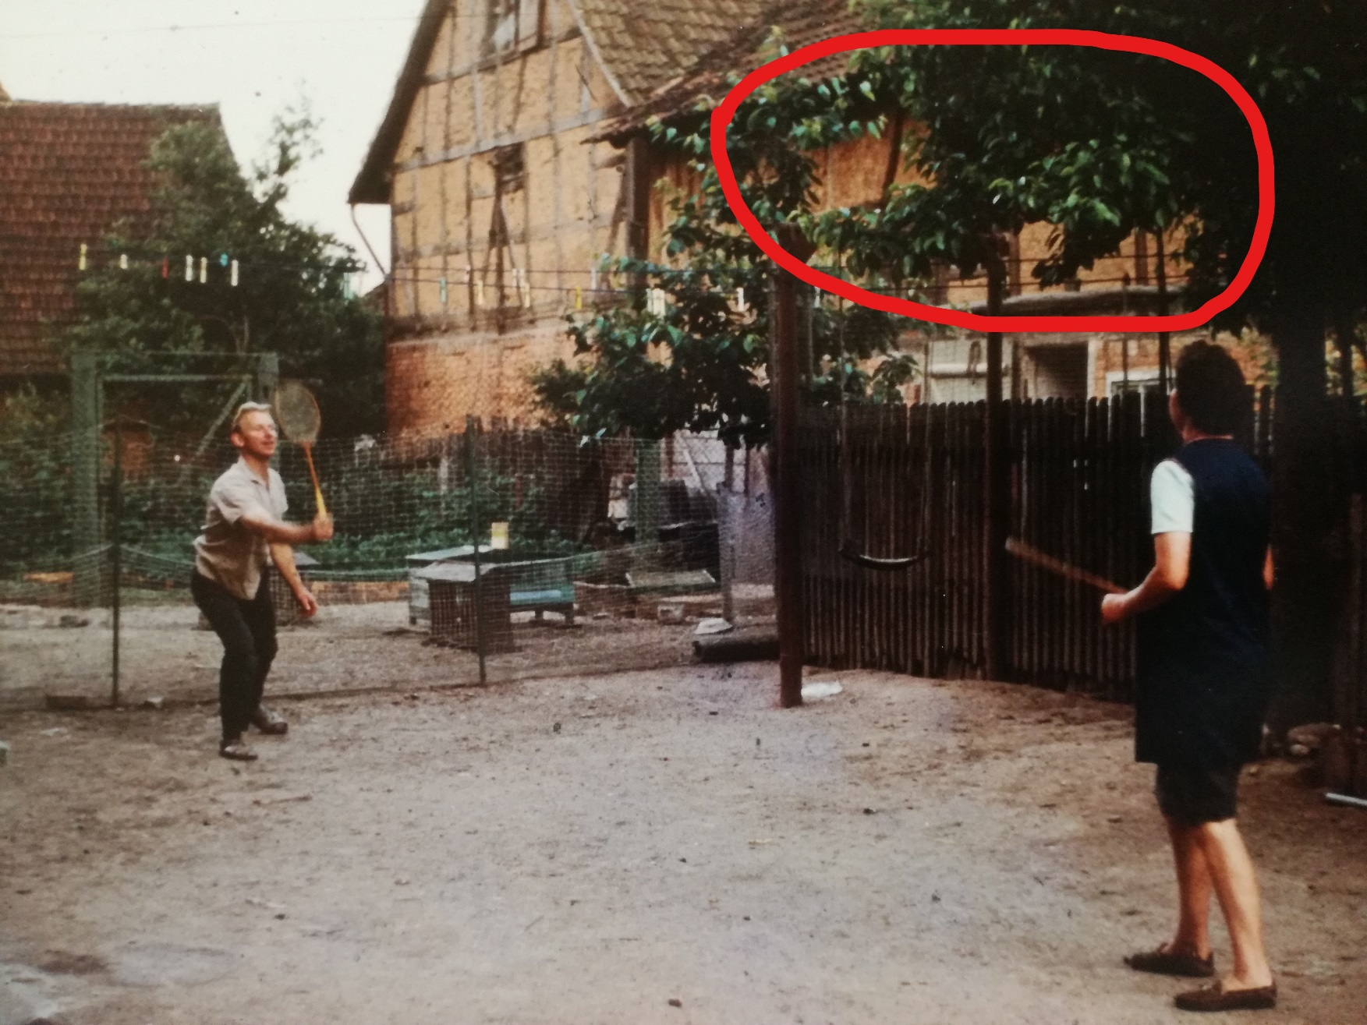

Slide 3
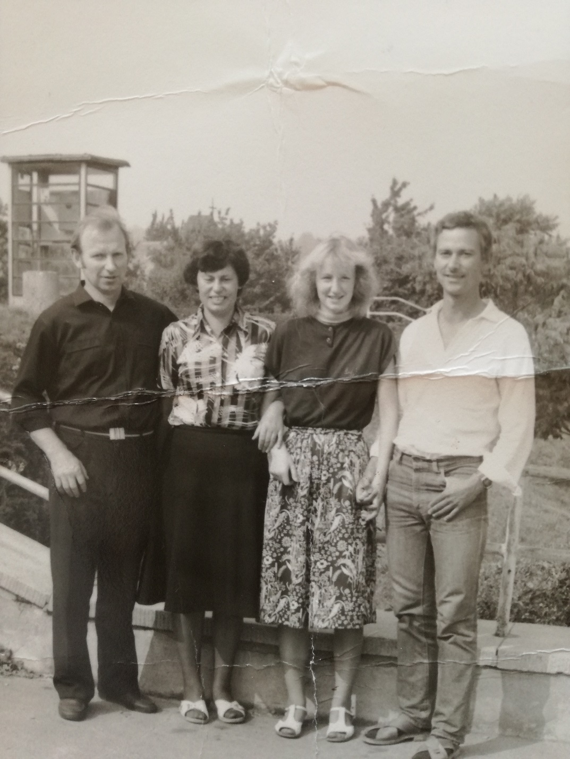

Slide 4
Josef Grusser aiding people who fled
1946-1948
„Green Border“
He helped people to cross the border before it was fully established
Punishments were not that sincere yet

Slide 5
